Slide 1


Code Red Dashboard
Code Red

Slide 2

TABLE OF CONTENTS
001
002
Team Members
Introduction
003
004
005
Our Process
The Result
Conclusion

Slide 3






OUR TEAM
Zainab Mustura
Sam Syed
Rani Wheeza
Mani
The UI Developer
The Backend Coder
The Designer
The Analyst

Slide 4



Introduction
Purpose: Designed to monitor and analyze NGINX access logs for detecting anomalies

Slide 5

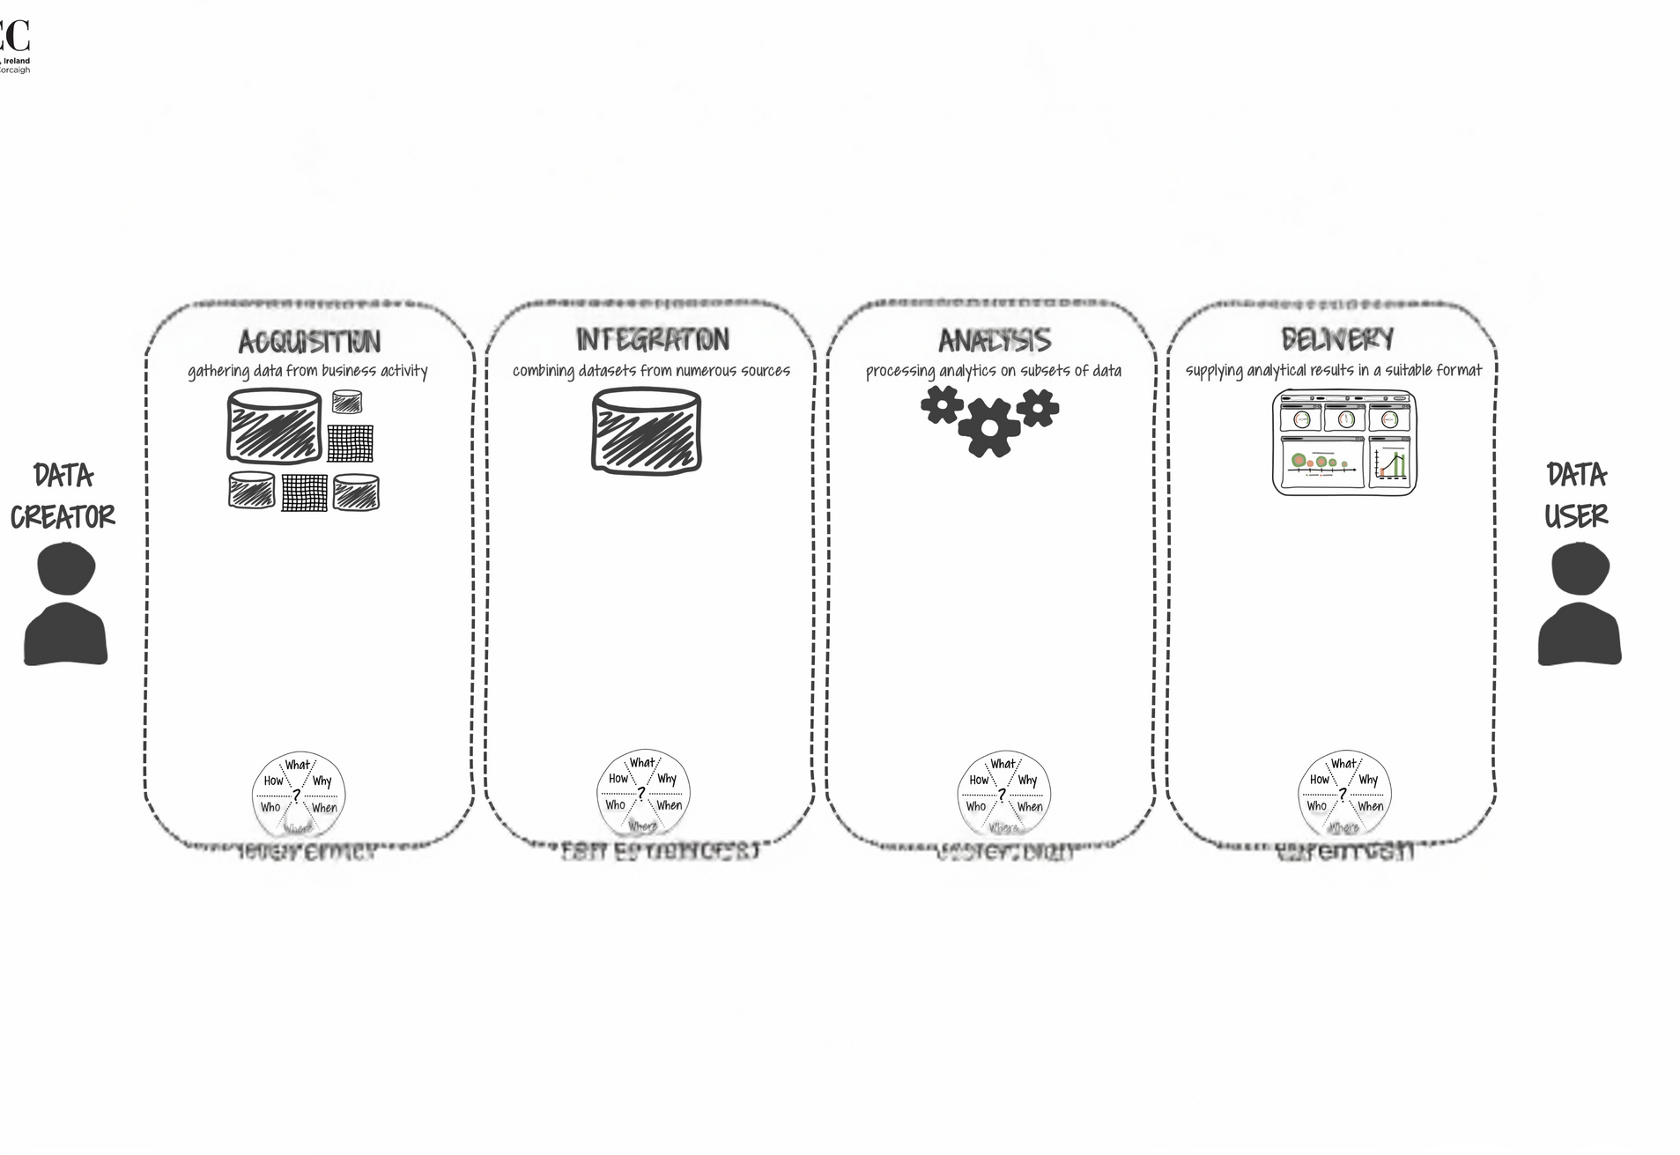
Our Process
Business value
Data Behaviour
Actionable Insights
Operational Efficiency
Anomaly Detection
Trend Analysis
Parse and separate log data to coloums in csv
Analyze the usability and effectiveness of anomalies and log data
A Dashboard web app with Interactive Features
Gather NGINX Logs

Slide 6

The Result
Website Link:

Slide 7


Thank you!!

